Slide 1
Molecular dynamics of human Serine Racemase
December 12th, 2019
Jared L. Hass

Slide 2
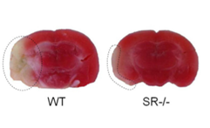
D-Serine and Human Serine Racemase
Only Racemase in human enzymology
D-serine is coactivator of NMDA (N-methyl-D-aspartate) receptors at the “glycine” site.
D-Serine is a hundred times more potent at coactivating the NMDA than glycine
NMDA receptors
associated with learning and memory
hypofunction is implicated in schizophrenia
hyperfunction is implicated in excitotoxicity of associated neurons
Brain damage due to stroke
and possibly other neurodegenerative diseases.
Representative images of a wild-type and SR^{−/−} brain 24 h post- SR^{−/−}mice display marked reduction in infarct area compared to wild-type littermates.
Wolosker, Neurochemistry International 41 (2002) 327–332
Snyder et al. The Journal of Neuroscience, 2010 30(4):1413–1416

Slide 3
Initial Project
Tried to take a .pdb file that has lysine bonded to the cofactor, PLP, labeled as a super amino acid
Relaxing hSR open structure (5X2L) to go back to the closed conformation of the protein (3L6B) with Gromacs using GPUs on the cluster
Tried working this problem backwards and finally got some results
Used the newest charmm36 force field for all MD experiments, charmm36 can handle these super amino acids much better

Slide 4
Basic Code for Gromacs
#!/bin/bash
#SBATCH --time=00:015:00
#SBATCH --partition=gpu
#SBATCH --gres=gpu:1
#SBATCH --mem=10g
#SBATCH --cpus-per-task=2
gmx grompp -f minim.mdp -c 3l6b-ions.gro -p topol.top -o em.tpr
gmx mdrun -v –deffnm em -nb gpu
Tried optimizing the code by using 2 gpus and assigning them specific tasks by using command –gputasks but each attempt slowed down the ns/hour
My understanding of gputasks 0011 it will set 1 gpu to run pme and the other to run some other task (I set mine to run nonbonding computation)
If gputasks is not assigned, Gromacs drops all but one gpu, no mater if you have gres=gpu:1<
There is a somewhat automated optimization by running gmx tune_pme but I could never get this running Conceptually it runs many short MD simulations running different number of PME ranks and figures out the fastest parameters
Running any sort of computation on 150000 coordinates with 160000 frames is time intensive
Can overcome this by running an interactive job on slurm
srun --nodes=1 --ntasks-per-node=8 --mem-per-cpu=1024 --pty $SHELL
This will allow you to run any command like usual without the timeout that occurs when doing longer jobs

Slide 5
Initial analysis of MD
Plot of Temperature, potential energy and kinetic
Quick analysis of system to make sure that everything ran smoothly

Slide 6
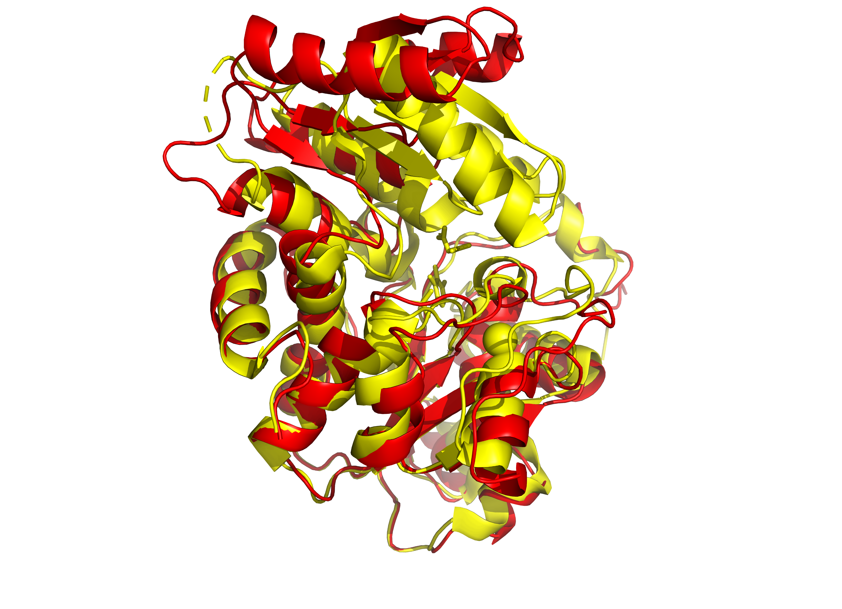
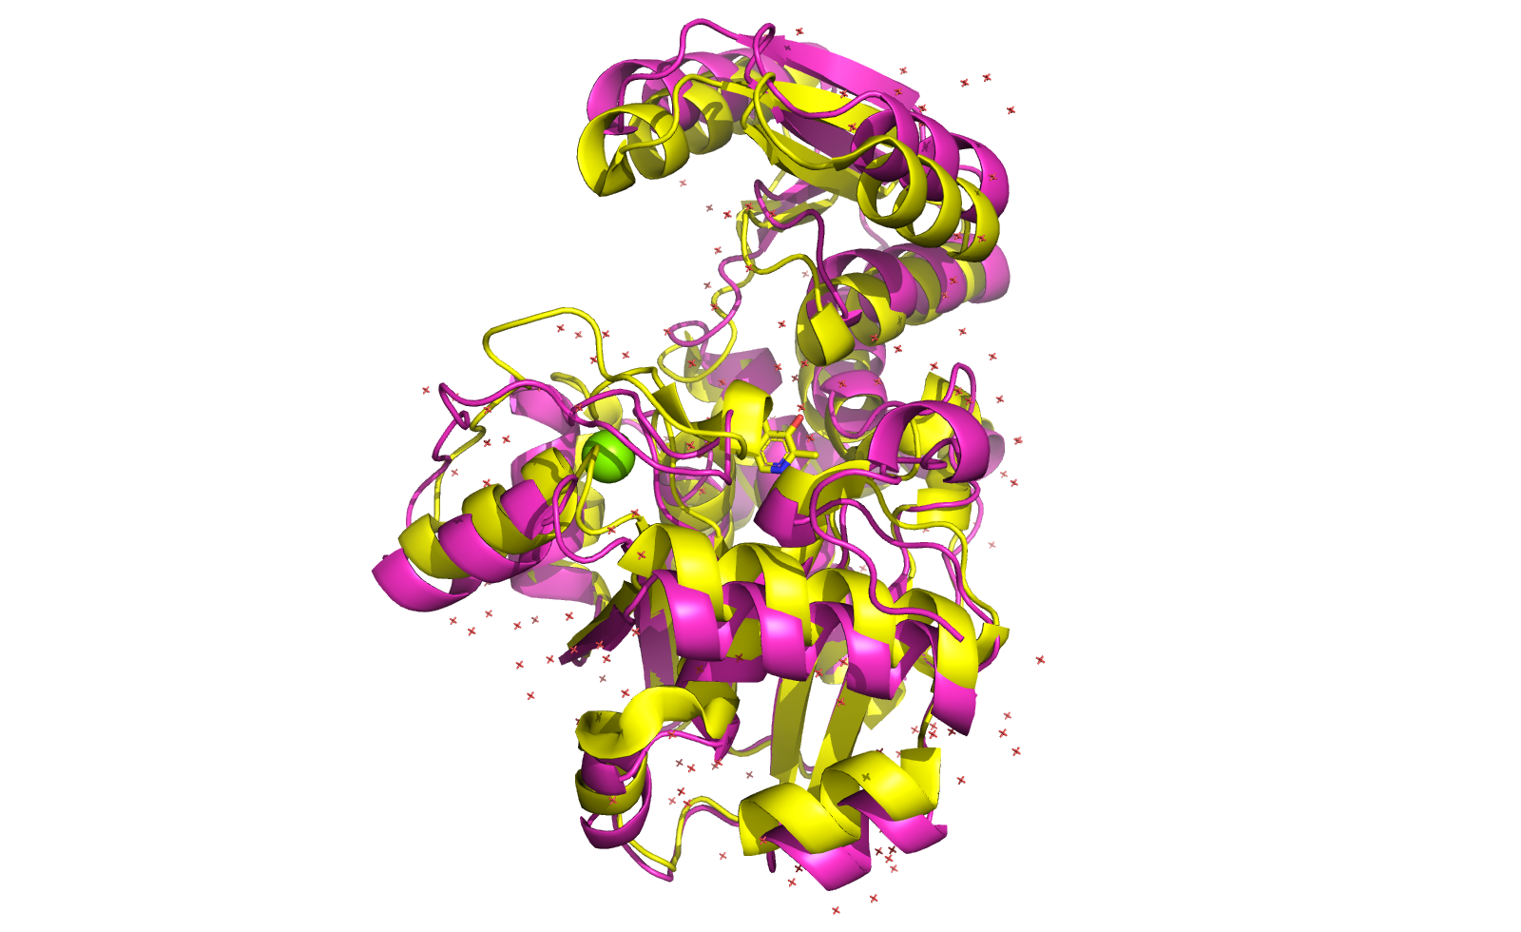
Comparison of last MD frame to crystal structures
MD compared to 3L6B, the original structure MD compared to 5X2L, the open structure

Slide 7
Flexibility of enzyme
Can easily get a graph of this by using command in gromacs gmx rmsf –o XXX.tpr –f XXXX.xtc –o XXX.xvg

Slide 8
Characteristics of meaningful MD’s
gmx rmsd –s XXX.tpr
gmx gyrate –f XXX.xtc –s XXX.tpr –o XXX.xvg

Slide 9
Issues to overcome
Obtaining a meaningful cluster
Adjusting the box to be a dodecahedron, saves computation time where it doesn’t explode my protein or won’t
Centering the .xtc file
Better incorporation of charmm36 into Protein ligand complex
Be able to figure how analyze a specific domain move (angle, distance, etc)

Slide 10
Future Work
Incorporate different docked inhibitors to see the see if the substrate/inhibitor binds to the protein and view the binding energy over time
Watch the enzyme and get a better idea how it behaves mechanistically. Ideally, an interaction between the protein and ligand that will favor closing, rather than opening.
Figure out a way to relax the internal aldimine, where PLP is covalently bound to Lysine
Apply this to our mechanism based inhibitor where it covalently binds to the lysine
Be able to more analytically analyze MD structures, possibly moving into multivariate analysis (PCA, LDA)

